Slide 1
Methods of lines
From last time:
Choose coordinate system based on geometry of your model domain
What are your assumptions about mass and energy transport (directions for different modes of transfer)?
Eliminate terms starting from the PDE GEs in the book/slides
NEXT STEP: discretize you PDE with method of lines (MOL)

Slide 2



method of lines for solving spatial models numerically
Lets simplify the advection-diffusion-reaction to a 1D problem
and assume diffusion is the only transport phenomena
.. transform to only 1D (x)
$$\frac{∂C_{A}}{∂t}=−v\frac{∂C_{A}}{∂x}+D\frac{∂^{2}C_{a}}{∂x^{2}}+R_{A}$$
.. remove advection and reaction
$$\frac{∂C_{A}}{∂t}=D\frac{∂^{2}C_{a}}{∂x^{2}}$$
Ca is the dependent state variable
t is time variable (independent),
x is spatial variable (independent)

Slide 3
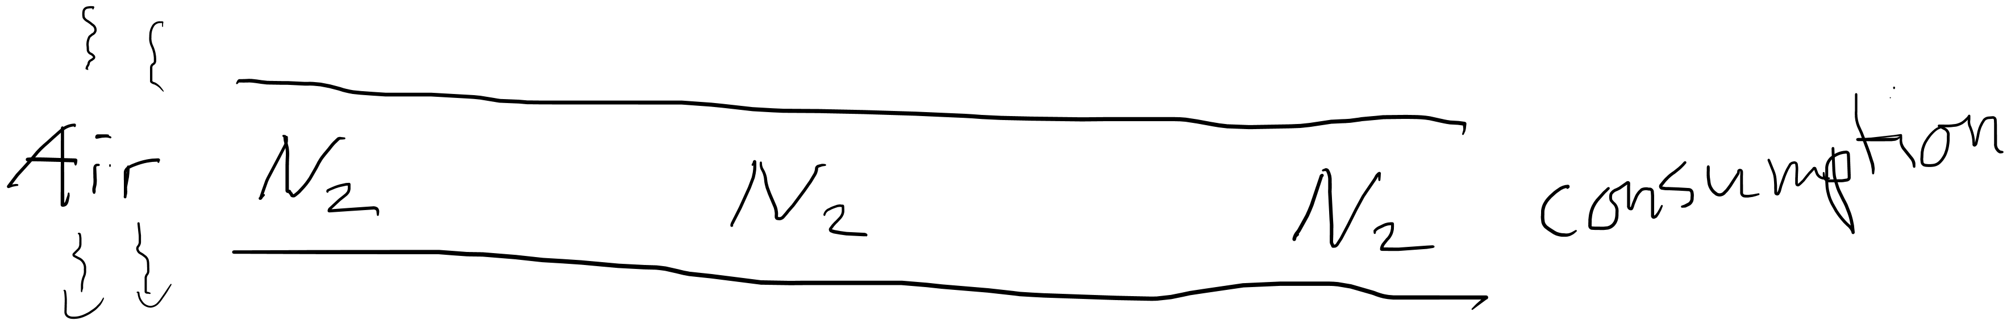

A pipe is open in one end where the oxygen concentration is equal to the
oxygen concentration in the air. The oxygen diffuses to the other end of the pipe where
oxygen is instantanuously consumed, such that the concentration is always 0 at the right end
x = 0 m
X = L = 1 m
C(t, 0 = 21%)
C(t, L = 0%)
Define initial and boundary values.
$$\frac{∂C_{A}}{∂t}=D\frac{∂^{2}C_{a}}{∂x^{2}}$$
Needs 1 initial value
Needs 2 boundary values

Slide 4
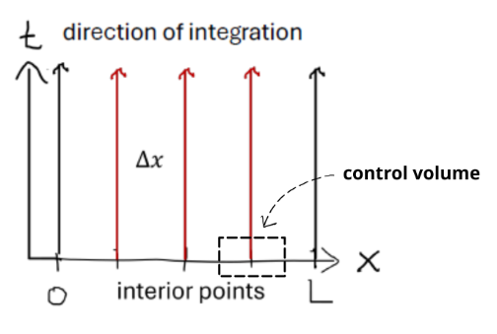
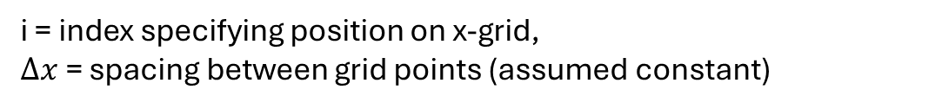

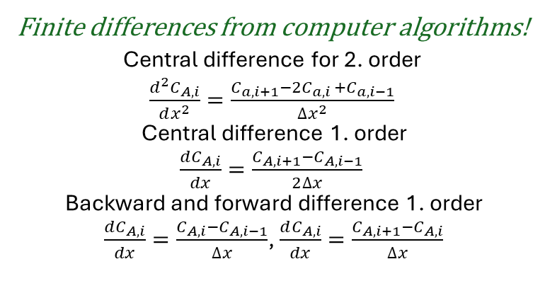

1) Replace only the spatial derivatives with finite difference approximations! (discretize the spatial derivative)
Finite differences from computer algorithms!
Central difference for 2. order
$\frac{d^{2}C_{A,i}}{dx^{2}}=\frac{C_{a,i+1}−2C_{a,i }+C_{a,i−1}}{{∆x}^{2}}$
Central difference 1. order
$\frac{dC_{A,i}}{dx}=\frac{C_{A,i+1}−C_{A,i−1}}{2∆x}$
Backward and forward difference 1. order
$\frac{dC_{A,i}}{dx}=\frac{C_{A,i}−C_{A,i−1}}{∆x}$, $\frac{dC_{A,i}}{dx}=\frac{C_{A,i+1}−C_{A,i}}{∆x}$
$$\frac{∂C_{A}}{∂t}=D\frac{∂^{2}C_{a}}{∂x^{2}}$$
$$\frac{∂C_{A}}{∂t}=D\frac{C_{a,i+1}−2C_{a,i }+C_{a,i−1}}{∆x^{2}}$$
i = index specifying position on x-grid,
$∆x$ = spacing between grid points (assumed constant)
2) discretize your space into n domains = n +1 nodes
Example with 4 domains, 5 nodes
See Appendix F in the book for finite difference formulas

Slide 5
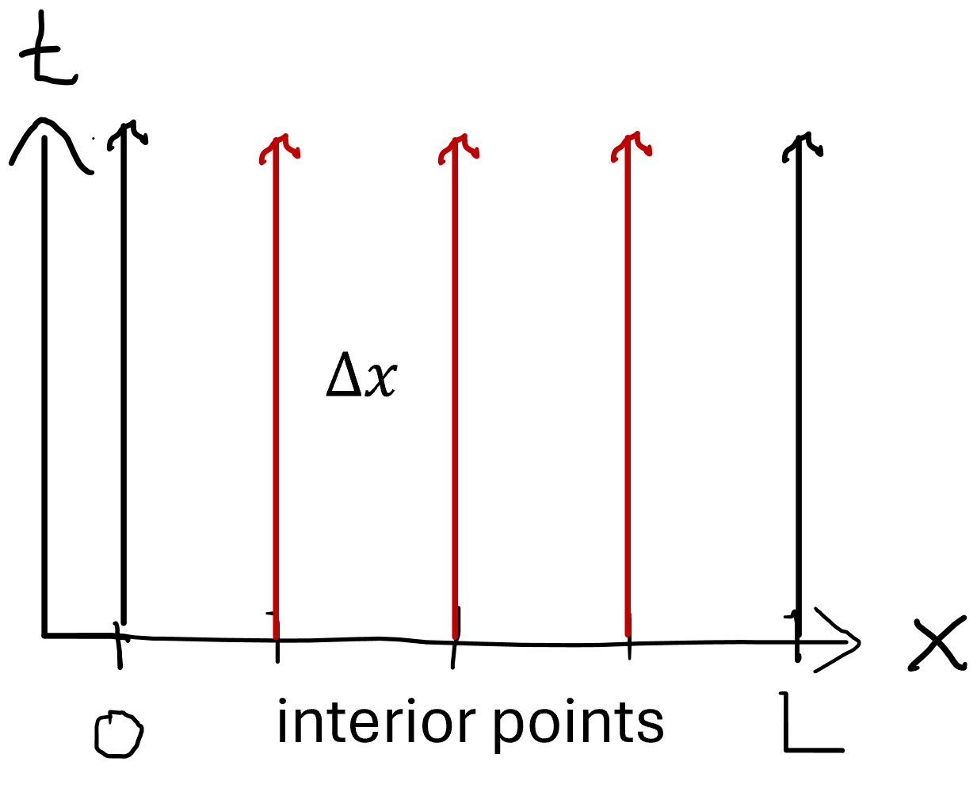

3) Make and ODE for each node
Value from boundary condition 1
$$\frac{∂C_{A,0}}{∂t}=0$$
$$\frac{∂C_{A,0.25}}{∂t}=D\frac{C_{a,x=0.5}−2C_{a,x=0.25 }+C_{a, x=0}}{{∆x}^{2}}$$
$$\frac{∂C_{A,0.50}}{∂t}=D\frac{C_{a,x=0.75}−2C_{a,x=0.50 }+C_{a, x=0.25}}{{∆x}^{2}}$$
$$\frac{∂C_{A,0.75}}{∂t}=D\frac{C_{a,x=1}−2C_{a,x=0.75 }+C_{a, x=0.50}}{{∆x}^{2}}$$
$$\frac{∂C_{A,1}}{∂t}=0$$
interior points
Value from boundary condition 2
Initial conditions have not been specified yet!

